Slide 1

CUI WAH CAMPUS
COMSATS University Islamabad, Wah Campus
Department of Computer Science
LECTURE # 8
SUBJECT NAME: Automata Theory
INSTRUCTOR: Waheed Ahmad Khan

Slide 2

Topic Covered
Revision Regular Expression
Finite Automata/ FA , Deterministic Finite Automata / DFA

Slide 3
EVEN-EVEN.
Language EVEN-EVEN defined by the expression:
[aa + bb + (ab + ba)(aa+bb)*(ab + ba)]*
Every word in EVEN-EVEN has an even number
of a’s and b’s.
Every word that contains an even number of a’s
and b’s is a member of EVEN-EVEN.

Slide 4
More Examples of RE
Even number of a’s
Odd Number of a’s
All words of length 4
All words in which a never double
All words do not contain ab
All words having substring aab or baa
All words of length 3 or more
All words of length 5 or less

Slide 5
Finite Automata/ FA , Deterministic Finite Automata / DFA
DEFINITION: A finite automaton is a collection of three things:
1. A finite set of states, one of which is designated as the initial state, called the start state, and some (maybe none) of which are designated as final states.
2. An alphabet I of possible input letters, from which are formed strings, that are to be read one letter at a time.
3. A finite set of transitions that tell for each state and for each letter of the input alphabet which state to go to next.

Slide 6
Deterministic Finite Automaton (DFA)
Finite Automaton can be classified into two types −
Deterministic Finite Automaton (DFA)
Non-deterministic Finite Automaton (NDFA / NFA

Slide 7
Deterministic Finite Automaton (DFA)
In DFA, for each input symbol, one can determine the state to which the machine will move. Hence, it is called Deterministic Automaton. As it has a finite number of states, the machine is called Deterministic Finite Machine or Deterministic Finite Automaton.

Slide 8
Formal Definition of a DFA
A DFA can be represented by a 5-tuple (Q, ∑, δ, q₀, F) where −
1. Q is a finite set of states.
2. ∑ is a finite set of symbols called the alphabet.
3. δ is the transition function where δ: Q × ∑ → Q
4. q₀ is the initial state from where any input is
processed (q₀ ∈ Q).
5. F is a set of final state/states of Q (F ⊆ Q).

Slide 9
Graphical Representation of a DFA
A DFA is represented by digraphs called state diagram.
The vertices represent the states.
The arcs labeled with an input alphabet show the transitions.
The initial state is denoted by an empty single incoming arc or - sign.
The final state is indicated by double circles or + sign.

Slide 10
Examples
Let a deterministic finite automaton be →
Q = {a, b, c},
∑ = {0, 1},
q₀ = {a},
F = {c}, and
Transition function δ as shown by the following table −
Present State | Next State for Input 0 | Next State for Input 1
a | a | b
b | c | a
c | b | c

Slide 11
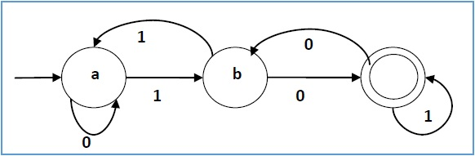
Deterministic Finite Automaton (DFA)
cc

Slide 12
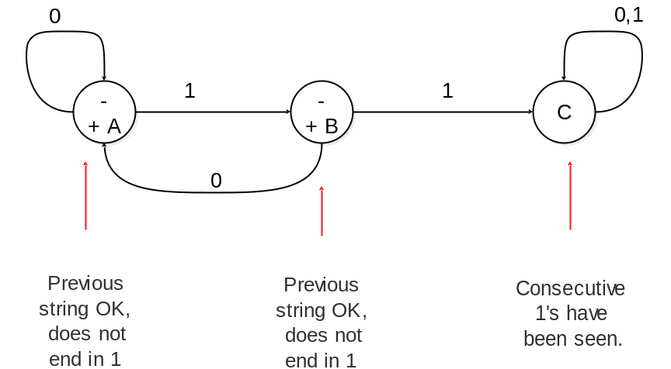
Deterministic Finite Automaton (DFA)
Construct DFA that Accepts all strings without two consecutive 1’s

Slide 13
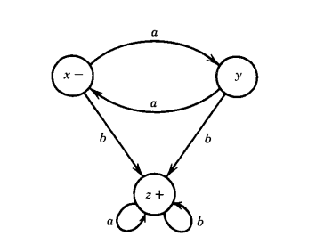
Deterministic Finite Automaton (DFA)
The below FA will accept all strings that have the letter b in them. Therefore, the language associated with (or accepted by) this FA is the one defined by the regular expression (a + b)*b(a + b)*

Slide 14
Thank You…

